Slide 1
Desktop application and static website for Yamuna art printers
Sixth semester project

Slide 2
Problem
Don’t have any automation for internal processes
To know about status of the order is difficult
Search for any order is very tidies job
Customer has to spend more time in selection of design
Lack of marketing.

Slide 3
Scope
By creating desktop application we can try to solve their problems such as keep track of the order, get any order detail by searching and even the problems which are there because of communication gap.
By creating website we can provide facility to customer to select design first. So their time which wasted during selection of the design will save.

Slide 4
Tools & Technology
Asp.net
Windows Presentation Foundation
Microsoft Expression Blend
CSS and jquery
Microsoft Visual Studio 2010
Microsoft Expression Blend 4
Edraw

Slide 5
Requirements
Functional Requirement
Edit order details
Create users
Change password
Delete order
Database backup and restore
Search order according to criteria
Generate and print reports
Delete user account

Slide 6
Non-functional requirement
Security
Backup
Disaster recovery
Extensibility
Performance

Slide 7
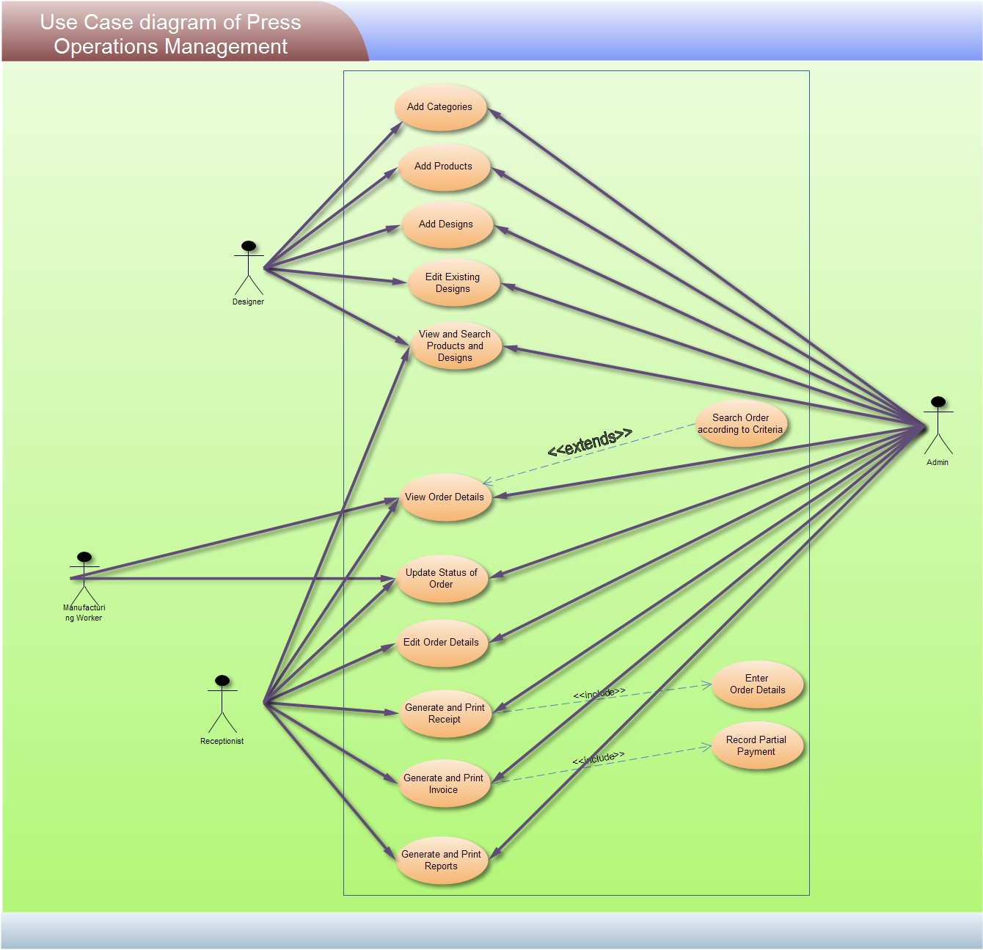
Use case diagram

Slide 8
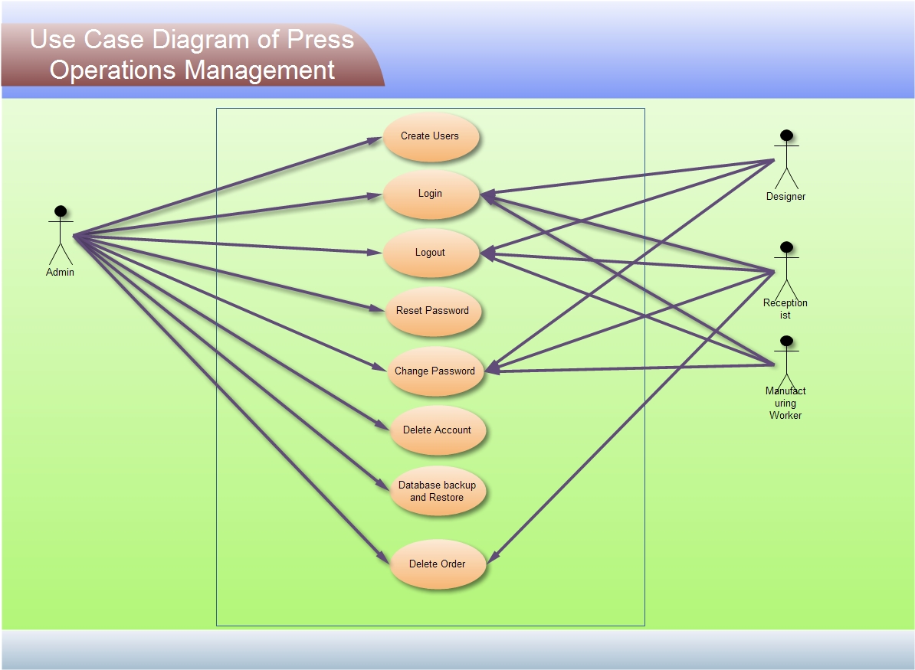

Slide 9
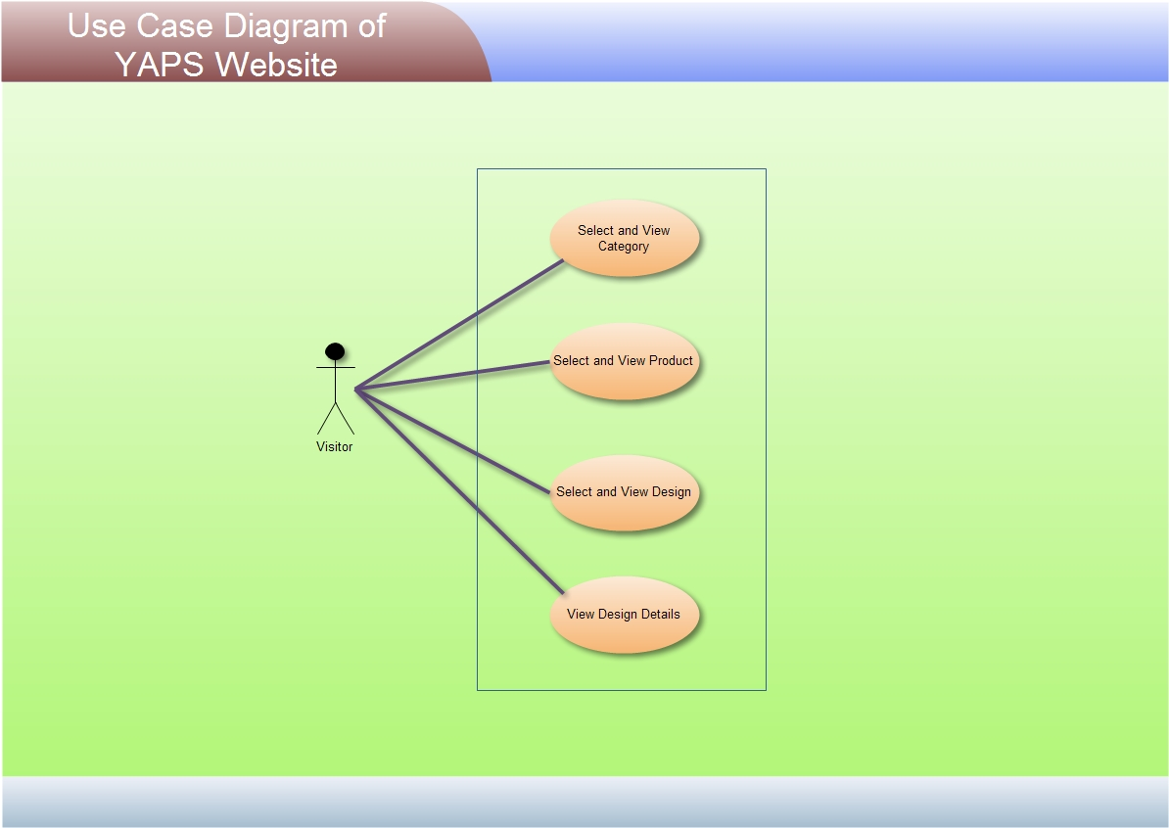
Use case diagram of website

Slide 10
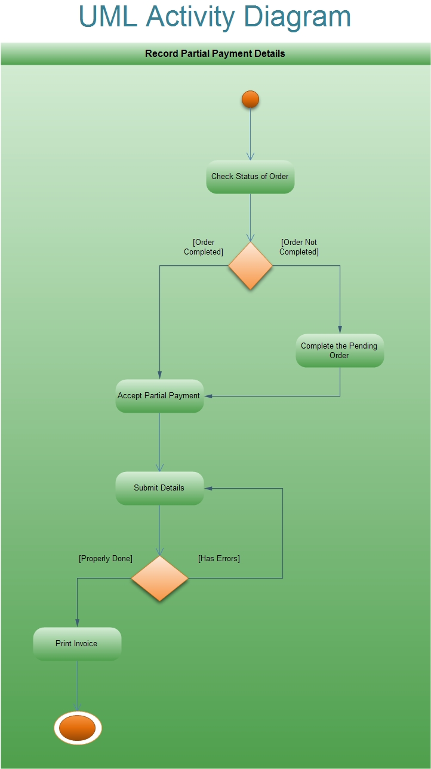

Slide 11
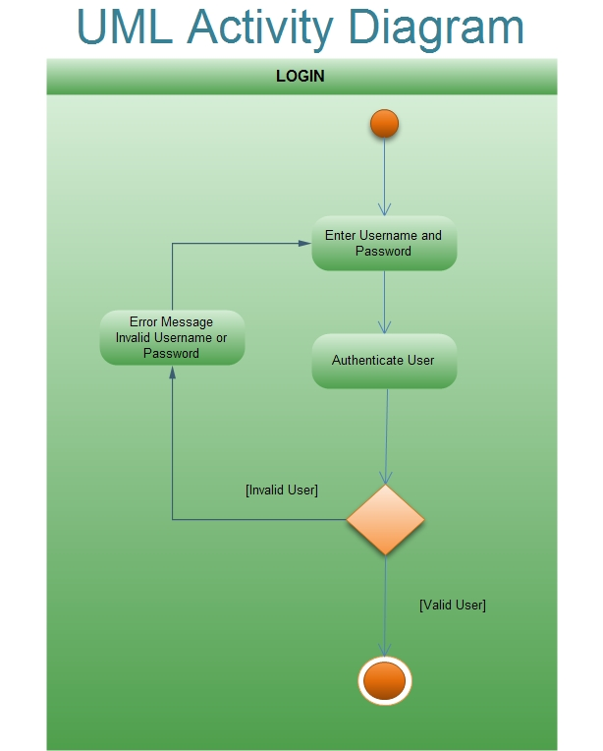

Slide 12
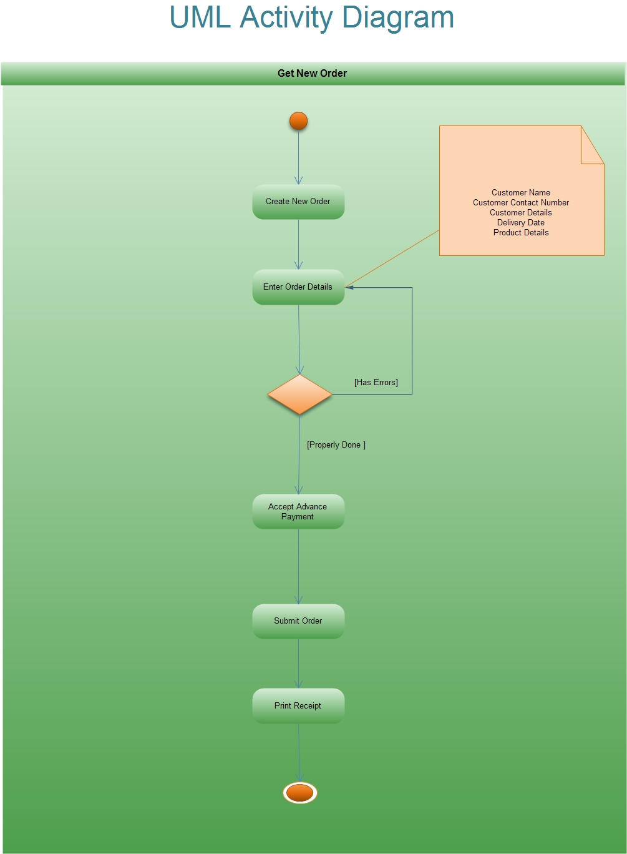

Slide 13
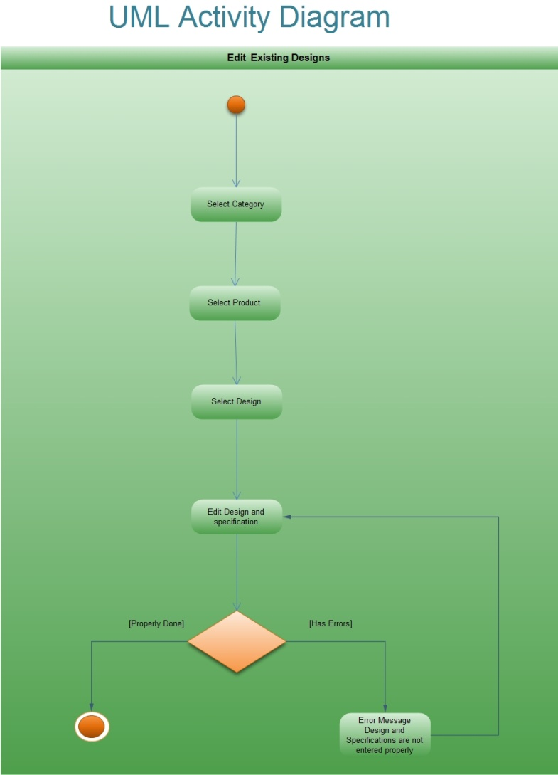

Slide 14
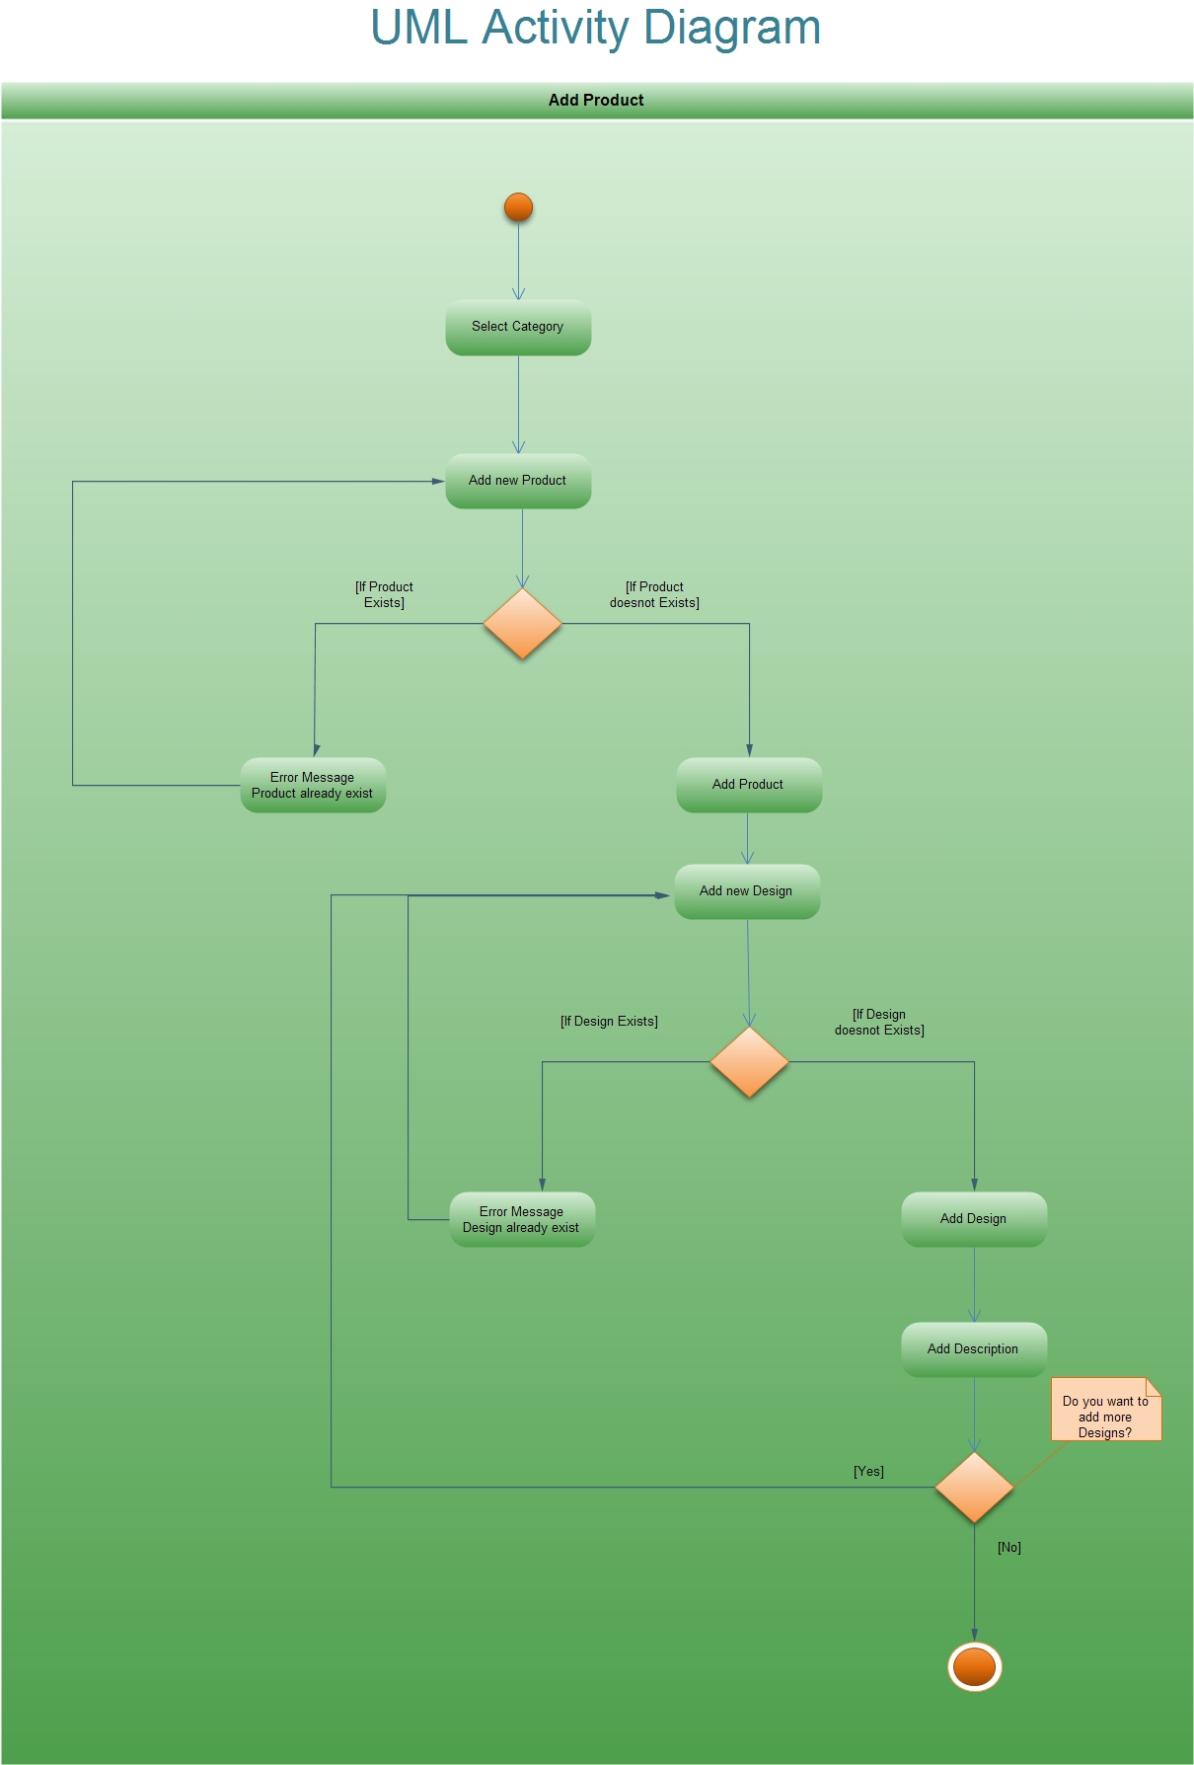

Slide 15
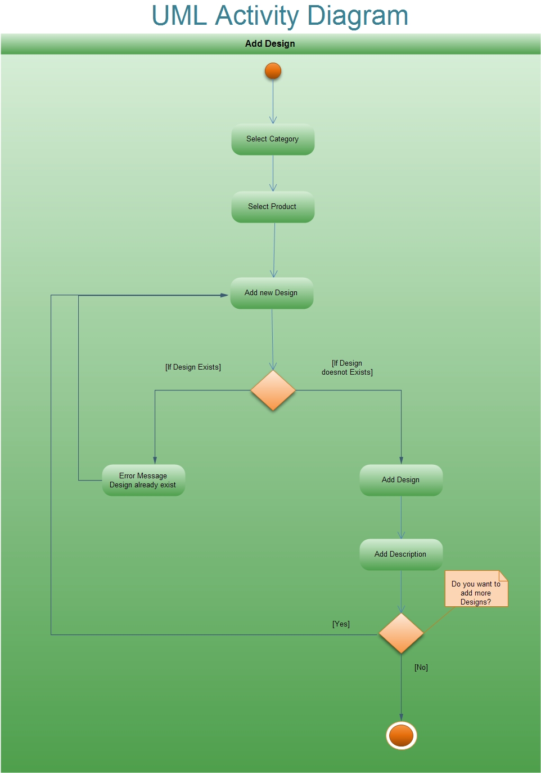

Slide 16
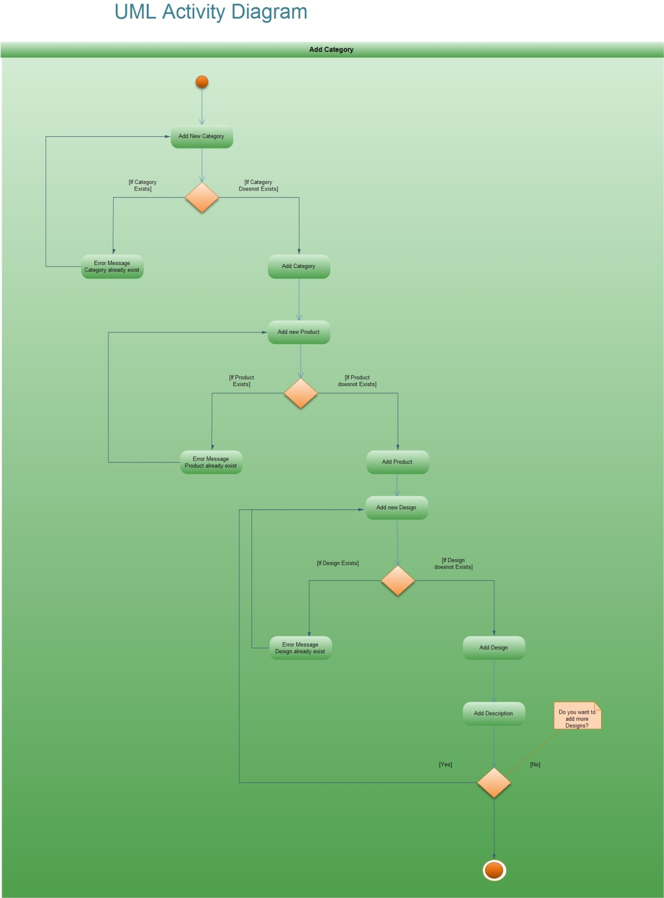

Slide 17
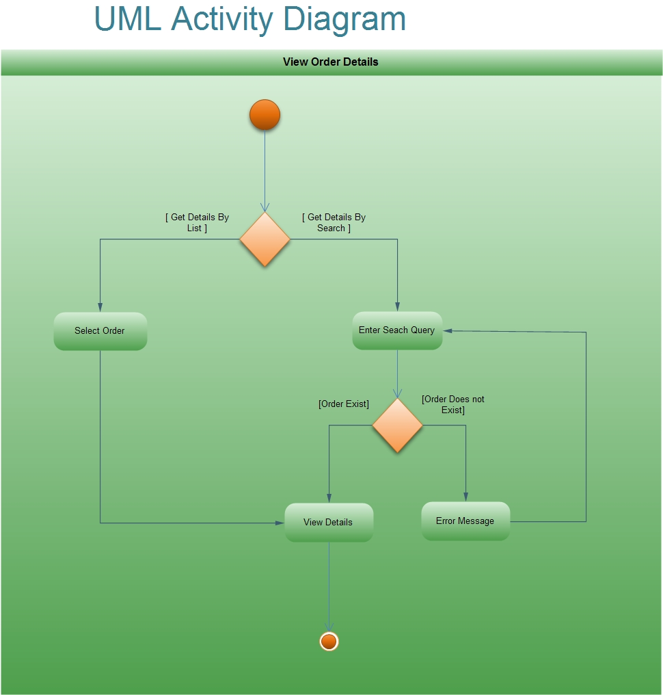

Slide 18
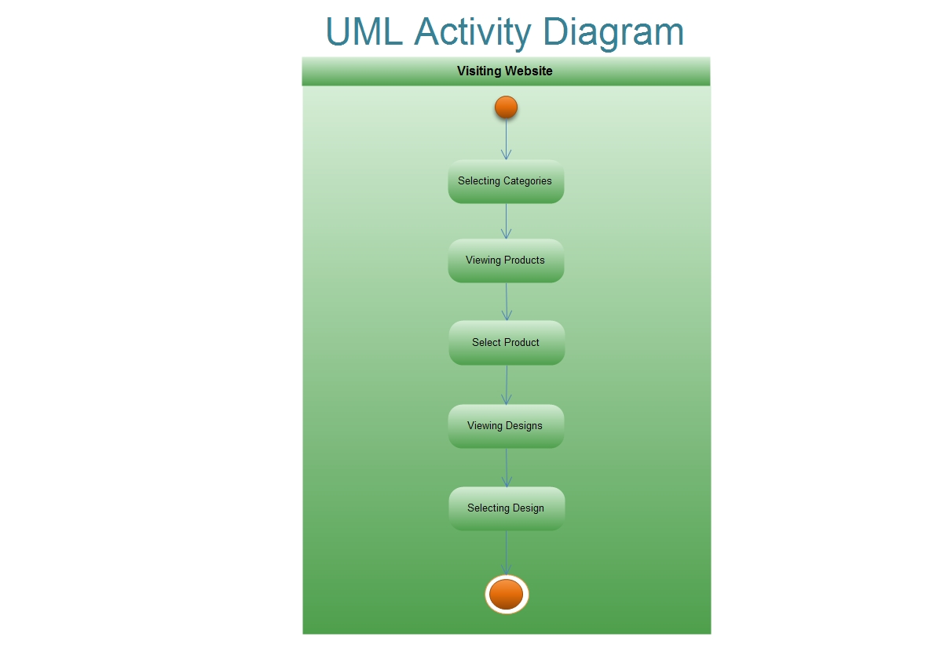

Slide 19
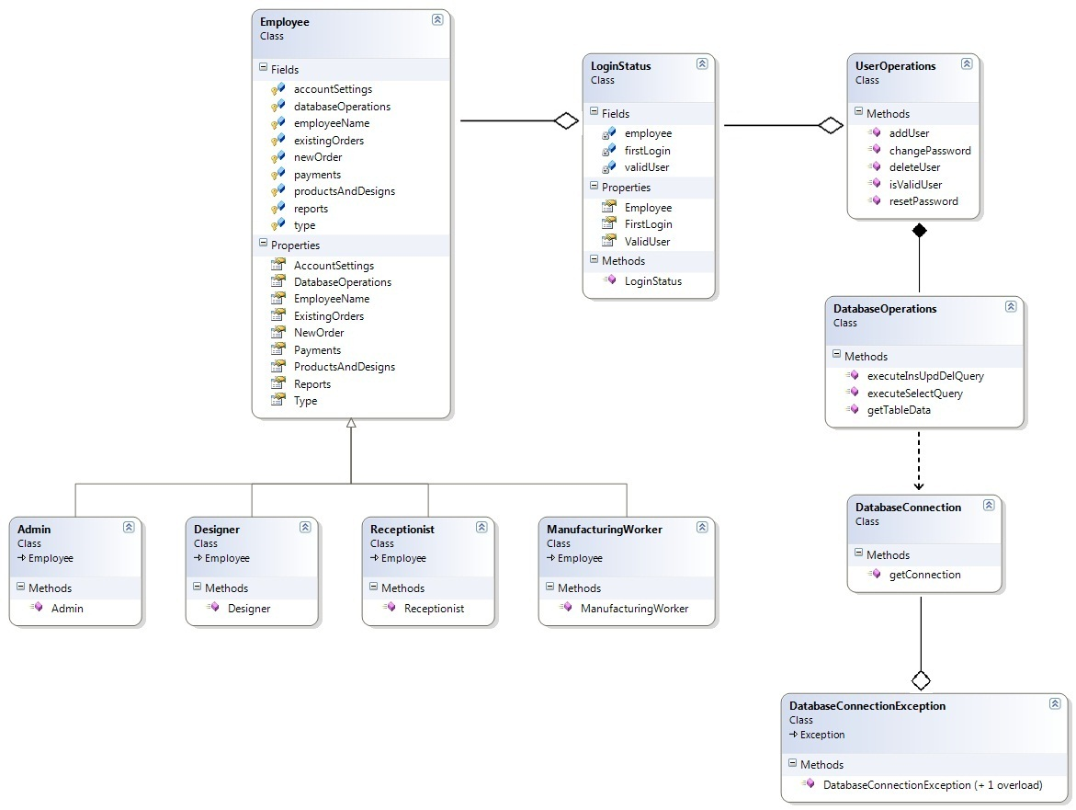

Slide 20
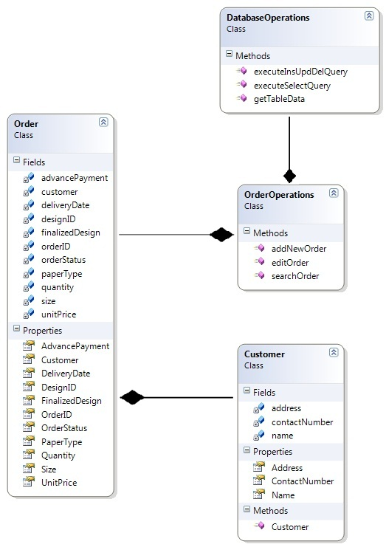

Slide 21
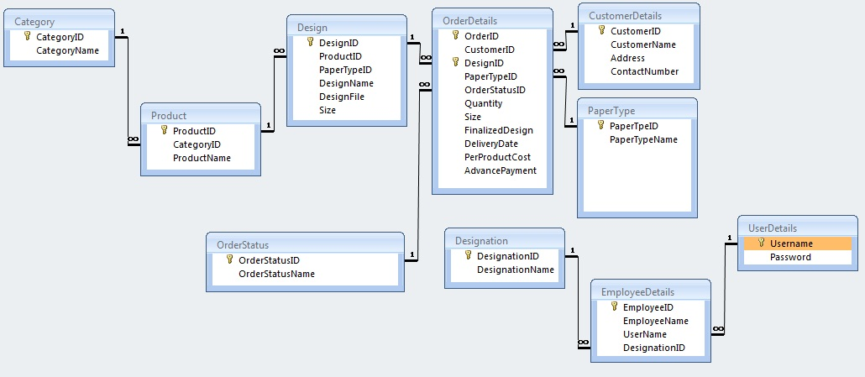

Slide 22
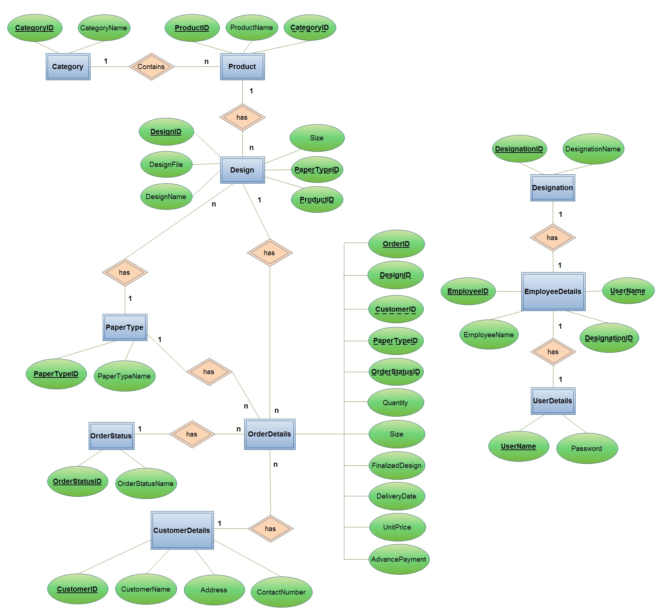

Slide 23
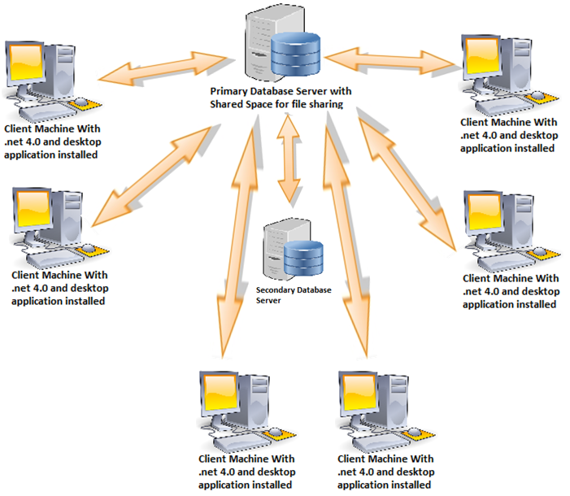
Deployment Diagram

Slide 24
THANK YOU
By
Nikki Punjabi
Manoj Aswani
Zankhan Joshi
Zoebali Maknojia

